Slide 1
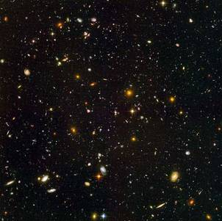
The year is 2071.
You have been given command
of the first space ship capable of reaching
our nearest neighbouring galaxies.
At each stage of your journey
you will need to answer a question.
Whether you get the answer correct or not
will determine what happens to you.
Beware, if you get too many questions wrong
your story will not end well!
To begin your mission press the button
To start press the button

Slide 2
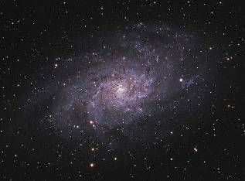
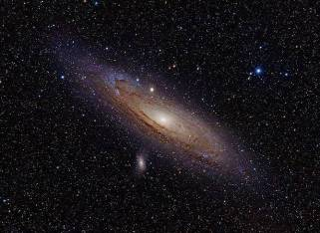
The two largest neighbouring galaxies are
To head towards To head towards
Triangulum Andromeda
press the button press the button
Triangulum
Andromeda

Slide 3
A 1

Slide 4
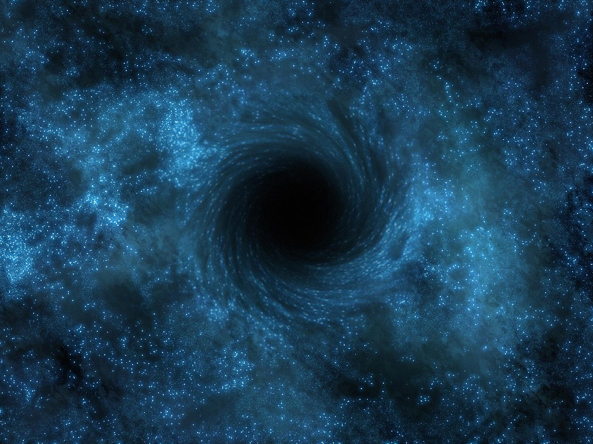
You soon arrive at the Triangulum galaxy,
the nearest large galaxy, a good place to begin your exploration.
You can see the black hole
which was discovered back in 2007,
still the largest black hole known.
Nobody has ever got close to a black hole.
You could learn a lot from approaching it.
Press the button

Slide 5
Question A 1 a
Calculate the area of the parallelogram below.
6 cm
5 cm
8 cm
48 cm²
40 cm²
24 cm²
20 cm²

Slide 6
Correct answer
Press the button

Slide 7
Wrong answer
Press the button

Slide 8
A 2

Slide 9
You decide that getting close to a black hole is too dangerous.
There is much more to explore.
You turn away from the black hole
and push the throttle.
Press the button

Slide 10
Question A 2 a
Calculate the area of the triangle below.
9 mm
7 mm
10 mm
35 mm²
70 mm²
45 mm²
90 mm²

Slide 11
Correct answer
Press the button

Slide 12
Wrong answer
Press the button

Slide 13
You fly slowly towards the black hole.
The ship begins to accelerate
and you realise that you are caught
in the gravitational force of the black hole.
You are being pulled towards it.
Press the button

Slide 14
Question A 2 b
Calculate the area of the triangle below.
8 m
6 m
9 m
24 m²
48 m²
27 m²
54 m²

Slide 15
Correct answer
Press the button

Slide 16
Wrong answer
Press the button

Slide 17
A 3

Slide 18
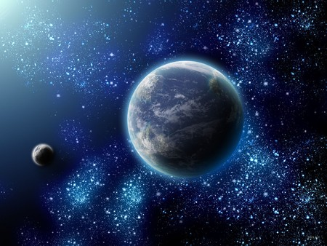
You pass by many beautiful planetary systems.
In one of the systems
you see a planet which looks like
it may be able to support life.
You decide to land and investigate.
Press the button

Slide 19
Question A 3 a
Calculate the perimeter of the shape below.
4 cm
5 cm
3 cm
6 cm
38 cm
26 cm
28 cm
18 cm

Slide 20
Correct answer
Press the button

Slide 21
Wrong answer
Press the button

Slide 22
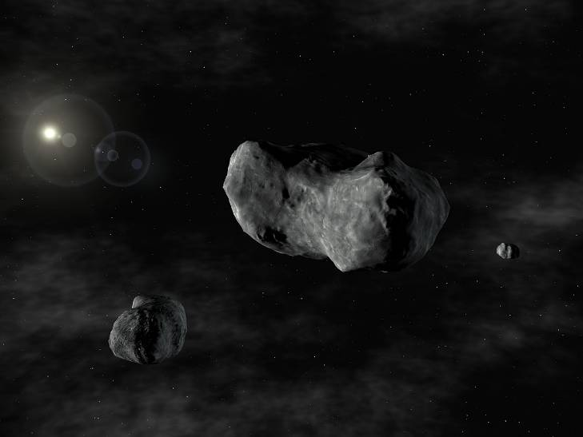
Flying through the galaxy you are stunned at the beauty.
Looking around in amazement
you do not notice
that you are heading towards
a small group of asteroids.
You are unable to avoid them
and one hits the ship.
Press the button

Slide 23
Question A 3 b
Calculate the perimeter of the shape below.
2 cm
3 cm
5 cm
7 cm
17 cm
30 cm
25 cm
41 cm

Slide 24
Correct answer
Press the button

Slide 25
Wrong answer
Press the button

Slide 26
You turn the ship
away from the black hole
and push the throttle to full power
in an attempt to overcome
the pull of the black hole.
Press the button

Slide 27
Question A 3 c
Calculate the perimeter of the shape below.
8 cm
5 cm
4 cm
2 cm
48 cm
28 cm
19 cm
34 cm

Slide 28
Correct answer
Press the button

Slide 29
Wrong answer
Press the button

Slide 30
The pull of the black hole
is too great for your ship’s engines.
You are being pulled backwards
into the black hole.
You begin to accelerate.
Everything becomes a blur.
And then nothing!
Press the button

Slide 31
A 4

Slide 32
You approach the planet
and enter into an orbit.
You take readings
and do the necessary calculations
to make sure it is safe to land.
Then you begin your descent
to the planet’s surface.
Press the button

Slide 33
Question A 4 a
Calculate the area of the shape below.
4 cm
8 cm
3 cm
6 cm
38 cm²
50 cm²
54 cm²
28 cm²

Slide 34
Correct answer
Press the button

Slide 35
Wrong answer
Press the button

Slide 36
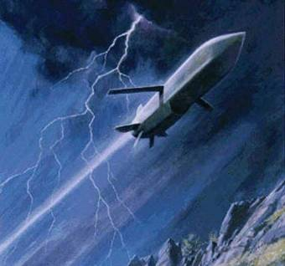
As you descend towards the planet’s surface
you are caught in a violent storm.
You struggle against the power
of the raging storm
which throws your ship around
as if it was a leaf in the wind.
Press the button

Slide 37
Question A 4 b
Calculate the area of the shape below.
4 cm
8 cm
3 cm
6 cm
50 cm²
38 cm²
54 cm²
28 cm²

Slide 38
Correct answer
Press the button

Slide 39
Wrong answer
Press the button

Slide 40
Damage alarms go off
and the cabin begins to lose pressure.
Press the button

Slide 41
Question A 4 c
Calculate the area of the shape below.
2 cm
9 cm
5 cm
7 cm
53 cm²
43 cm²
88 cm²
32 cm²

Slide 42
Correct answer
Press the button

Slide 43
Wrong answer
Press the button

Slide 44
The asteroid rips a huge hole
in the outer skin of the ship.
The air inside begins to escape
making the hole bigger
until the hull cracks
and the ship is torn apart!
Press the button

Slide 45
The ship begins to slow down
as the engines overcome the force
of the black hole.
Press the button

Slide 46
Question A 4 d
Calculate the area of the shape below.
8 cm
5 cm
9 cm
2 cm
34 cm²
92 cm²
48 cm²
58 cm²

Slide 47
Correct answer
Press the button

Slide 48
Wrong answer
Press the button

Slide 49
The pull of the black hole
is too great for your ship’s engines.
You are being pulled backwards
into the black hole.
You begin to accelerate towards it.
Everything becomes a blur.
And then nothing!
Press the button

Slide 50
A 5

Slide 51
You land safely
on the surface of the planet
and get ready to go outside
to begin your exploration.
Press the button

Slide 52
Question A 5 a
Calculate the surface area of the cuboid below.
3 m
6 m
8 m
180 m²
90 m²
17 m²
144 m²

Slide 53
Correct answer
Press the button

Slide 54
Wrong answer
Press the button

Slide 55
You must have made an error
in your landing calculations.
The ship lands harder than expected
and you sustain some damage
to the thrusters needed to take off again.
Press the button

Slide 56
Question A 5 b
Calculate the surface area of the cuboid below.
4 cm
5 cm
9 cm
101 cm²
202 cm²
18 cm²
180 cm²

Slide 57
Correct answer
Press the button

Slide 58
Wrong answer
Press the button

Slide 59
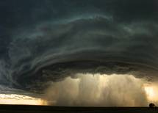
You manage to land the ship.
With a storm this violent
you are unable to leave the ship
to explore the planet.
Until the storm stops
you will not be able to take off again.
Press the button

Slide 60
Question A 5 c
Calculate the surface area of the cuboid below.
2 m
5 m
7 m
70 m²
14 m²
59 m²
118 m²

Slide 61
Correct answer
Press the button

Slide 62
Wrong answer
Press the button

Slide 63
Your ship crash lands.
You are alive, but the ship cannot be repaired.
You are destined to spend
the remainder of your existence
on this stormy planet!
Press the button

Slide 64
You manage to stop the leak,
but there is a lot of damage to the ship.
You need to repair the damage
or you will not make it home.
Press the button

Slide 65
Question A 5 d
Calculate the surface area of the cuboid below.
3 m
5 m
8 m
158 m²
79 m²
16 m²
120 m²

Slide 66
Correct answer
Press the button

Slide 67
Wrong answer
Press the button

Slide 68
You manage to stop the leak,
but the ship is too badly damaged.
The repair will not last long.
It looks like this will be
the end of your adventure.
Press the button

Slide 69
The ship stops
and then begins to accelerate
away from the black hole.
You are pushing the ship too hard
and damage alarms begin to sound.
Press the button

Slide 70
Question A 5 e
Calculate the surface area of the cuboid below.
4 cm
6 cm
9 cm
216 cm²
19 cm²
228 cm²
114 cm²

Slide 71
Correct answer
Press the button

Slide 72
Wrong answer
Press the button

Slide 73
The ship slows down
and eventually stops
at a point where the force of the engines
is matched by the pull of the black hole.
You are no longer
being pulled into the black hole,
but neither can you escape it!
Press the button

Slide 74
A 6

Slide 75
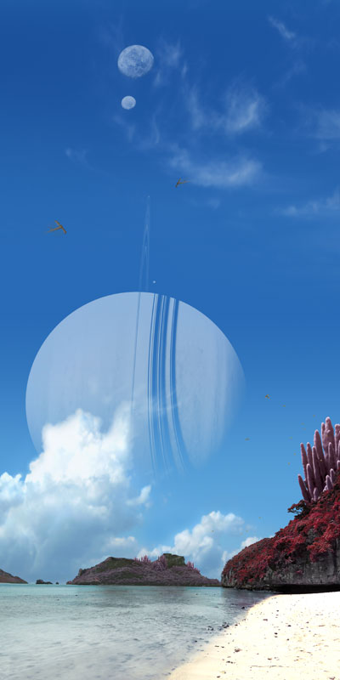
You find that the planet
is capable of supporting life.
You spend months here taking samples
and recording data.
Finally you decide to head for home.
Press the button

Slide 76
Question A 6 a
Calculate the volume of the cuboid below.
3 m
6 m
8 m
17 m³
144 m³
90 m³
180 m³

Slide 77
Correct answer
Press the button

Slide 78
Wrong answer
Press the button

Slide 79
The atmosphere is suitable for human life
and there is water available.
After weeks of searching
all you find
is a lifeless rocky landscape.
Press the button

Slide 80
Question A 6 b
Calculate the volume of the cuboid below.
3 m
6 m
8 m
90 m³
180 m³
17 m³
144 m³

Slide 81
Correct answer
Press the button

Slide 82
Wrong answer
Press the button

Slide 83
You manage to repair the damage to the ship
and then you begin your exploration of the planet.
You find that the planet
has everything needed to support human life.
Press the button

Slide 84
Question A 6 c
Calculate the volume of the cuboid below.
4 cm
5 cm
9 cm
101 cm³
202 cm³
180 cm³
18 cm³

Slide 85
Correct answer
Press the button

Slide 86
Wrong answer
Press the button

Slide 87
You are unable to repair the damage
to the thrusters.
The planet is beautiful
and has everything needed
to support human life.
It looks like this place
will become your new home.
Press the button

Slide 88
At last the storm subsides
and you are able to leave the ship.
The planet is beautiful
and has everything needed
to support human life.
Press the button

Slide 89
Question A 6 d
Calculate the volume of the cuboid below.
2 m
5 m
7 m
59 m³
118 m³
14 m³
70 m³

Slide 90
Correct answer
Press the button

Slide 91
Wrong answer
Press the button

Slide 92
Months pass and the storms continue.
It doesn’t looks like the storm will end.
You attempt to leave,
but the ship cannot fight the storm.
You are trapped on the planet
and your supplies are running out!
Press the button

Slide 93
After several hours
you manage to repair the ship,
unsure whether you have done enough
to get home.
Press the button

Slide 94
Question A 6 e
Calculate the volume of the cuboid below.
3 m
5 m
8 m
120 m³
16 m³
79 m³
158 m³

Slide 95
Correct answer
Press the button

Slide 96
Wrong answer
Press the button

Slide 97
You take a look at the damage
and realise that it is too bad to repair.
It looks like this will be
the end of your adventure.
Press the button

Slide 98
Once free from the black hole
you check the damage.
You will need to make repairs
if you are to make it home.
Press the button

Slide 99
Question A 6 f
Calculate the volume of the cuboid below.
4 cm
6 cm
9 cm
19 cm³
216 cm³
114 cm³
228 cm³

Slide 100
Correct answer
Press the button

Slide 101
Wrong answer
Press the button

Slide 102
You escape the black hole,
but the damage to your ship is too great.
You will not be able to return home!
Press the button

Slide 103
Complete endings A

Slide 104
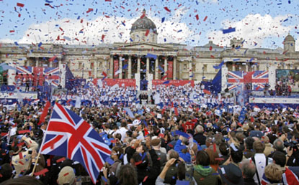
You arrive home safely
with the news that you have discovered a planet
that is capable of supporting human life.
Your studies have shown
that the planet has
an abundance of natural resources.
Crowds gather in the streets
to get a glimpse of
the most famous explorer
who has ever lived.
Press the button

Slide 105
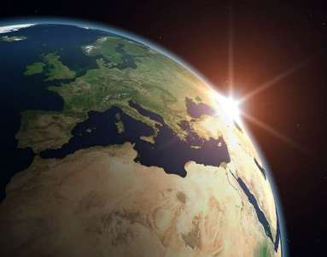
You arrive home safely.
You share the news
that you have discovered a planet
that is capable of supporting human life.
This is the greatest discovery
made in space
and with it you become known
as a great explorer.
Press the button

Slide 106
You keep searching
and eventually you find
all that is necessary
for humans to be able to survive here.
You return home
and share the news
that you have discovered a planet
that is capable of supporting human life.
You become the most famous explorer
there has been.
Press the button

Slide 107
After several weeks
you find an area that is capable of supporting life.
You decide to stay
and make this new planet your home.
Maybe one day you will return to Earth.
Press the button

Slide 108
You return home
and share the news
that you have discovered a planet
that is capable of supporting human life.
You become the most famous explorer
there has been.
Press the button

Slide 109
You decide to stay
and make this planet your new home.
Maybe one day you will return to Earth.
Press the button

Slide 110
You return home
and share the news
that you have discovered a planet
that is capable of supporting human life.
You become the most famous explorer
there has been.
Press the button

Slide 111
You decide to stay
and make this planet your new home.
Maybe one day you will return to Earth.
Press the button

Slide 112
Your repairs last long enough
to get you all the way home.
Although you didn’t approach
the black hole,
your ship recorded important information
that will help our understanding
of the universe.
You are a hero.
Press the button

Slide 113
You head for home
but you haven’t travelled far before the alarms begin again.
You make an emergency landing
on a nearby planet.
The ship cannot be repaired.
This planet will become your home.
Maybe you will be rescued one day.
Press the button

Slide 114
You repair the ship enough
to get you back home.
The information you collected
from the black hole
will greatly help our understanding
of the universe.
You are a hero.
Press the button

Slide 115
You make repairs to the ship,
but they will not be enough to get you home.
You will have to hope
you can find a planet here
that is capable of supporting life
and make it your new home.
Press the button

Slide 116
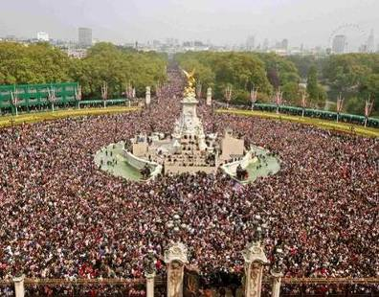
They are so thankful for your help
that they share all their knowledge with you.
You return home
with news of another civilization
and with a vast amount of knowledge.
You are invited to Buckingham Palace
where the Queen knights you.
Crowds gather outside
to get a glimpse of
the most famous explorer
who has ever lived.
Press the button

Slide 117
B 1

Slide 118
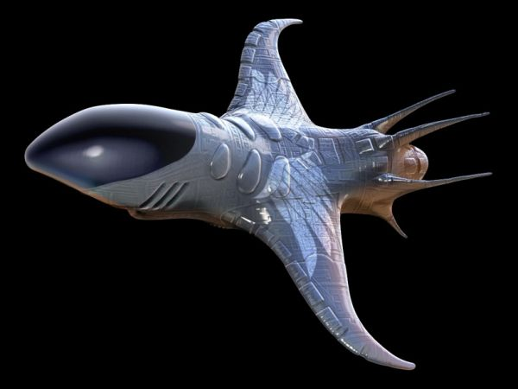
You arrive safely at the outer limits of the Andromeda galaxy,
the largest neighbouring galaxy.
You are now entering uncharted space.
The ship’s display beeps
and shows an object
moving towards you at high speed.
Out of the window
you see a small dot in the distance
which quickly becomes
an approaching space ship.
Press the button

Slide 119
Question B 1 a
The perimeter of the rectangle below is 24 cm.
What is the length of side x?
x
8 cm
16 cm
3 cm
4 cm
8 cm

Slide 120
Correct answer
Press the button

Slide 121
Wrong answer
Press the button

Slide 122
B 2

Slide 123
You send the radio message
which was prepared in case of contact with alien life,
expressing your peaceful intentions.
The approaching ship slows down
as it draws closer.
Press the button

Slide 124
Question B 2 a
The area of the triangle below is 24 cm².
Calculate the height of the triangle.
8 cm
16 cm
1.5 cm
3 cm
6 cm

Slide 125
Correct answer
Press the button

Slide 126
Wrong answer
Press the button

Slide 127
The alien ship begins to fire at you.
Your ship is hit
and damage alarms begin to sound.
Press the button

Slide 128
Question B 2 b
The area of the triangle below is 27 cm².
Calculate the height of the triangle.
9 cm
18 cm
1.5 cm
3 cm
6 cm

Slide 129
Correct answer
Press the button

Slide 130
Wrong answer
Press the button

Slide 131
B 3

Slide 132
Three figures materialise on your flight deck.
The aliens have many similarities to humans
which immediately puts you at ease.
Press the button

Slide 133
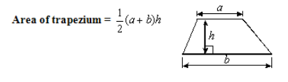
Question B 3 a
Calculate the area of the trapezium below.
4 cm
5 cm
10 cm
25 cm²
70 cm²
35 cm²
19 cm²

Slide 134
Correct answer
Press the button

Slide 135
Wrong answer
Press the button

Slide 136
A small panel opens on the front of the ship
and it begins to fire at you.
Press the button

Slide 137
Question B 3 b
Calculate the area of the trapezium below.
4 cm
6 cm
12 cm
36 cm²
22 cm²
96 cm²
48 cm²

Slide 138
Correct answer
Press the button

Slide 139
Wrong answer
Press the button

Slide 140
The ship’s display beeps again
and shows another object approaching.
The ship which attacked you speeds away
followed by another which is now firing at it.
Press the button

Slide 141
Question B 3 c
Calculate the area of the trapezium below.
3 cm
4 cm
9 cm
18 cm²
16 cm²
48 cm²
24 cm²

Slide 142
Correct answer
Press the button

Slide 143
Wrong answer
Press the button

Slide 144
You do not have time to do anything
as there is an explosion in your ship
and your mission abruptly ends!
Press the button

Slide 145
B 4

Slide 146
You hear the aliens speak to you in your mind.
They tell you that their sun is dying.
They are searching the galaxy
for a planet suitable of supporting life.
They ask if you have come across
such a planet on your travels.
Press the button

Slide 147
Question B 4 a
Calculate the surface area of the prism below.
13 cm
12 cm
10 cm
5 cm
360 cm²
420 cm²
600 cm²
300 cm²

Slide 148
Correct answer
Press the button

Slide 149
Wrong answer
Press the button

Slide 150
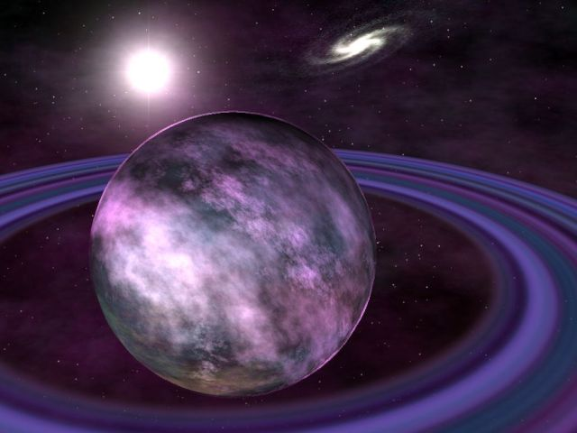
The aliens overpower you
and take control of your ship.
Two of them hold you
whilst the other one pilots your ship
to their planet.
Press the button

Slide 151
Question B 4 b
Calculate the surface area of the prism below.
15 cm
12 cm
10 cm
9 cm
576 cm²
468 cm²
1080 cm²
540 cm²

Slide 152
Correct answer
Press the button

Slide 153
Wrong answer
Press the button

Slide 154
You turn your ship away from theirs
and fly at full speed away from them.
Press the button

Slide 155
Question B 4 c
Calculate the surface area of the prism below.
10 cm
8 cm
9 cm
6 cm
432 cm²
216 cm²
312 cm²
264 cm²

Slide 156
Correct answer
Press the button

Slide 157
Wrong answer
Press the button

Slide 158
Your ship is hit.
The ship is designed for exploration not defence,
so the hit tears a huge hole
in the skin of your ship.
The sudden escape of air
into the empty void of space
tears your ship apart!
Press the button

Slide 159
That was a lucky escape.
You don’t want to hang around,
but first you need to
find somewhere to land
and repair the damage to the ship.
Press the button

Slide 160
Question B 4 d
Calculate the surface area of the prism below.
5 cm
4 cm
7 cm
3 cm
108 cm²
96 cm²
84 cm²
42 cm²

Slide 161
Correct answer
Press the button

Slide 162
Wrong answer
Press the button

Slide 163
Just as you’re thinking
what a lucky escape you’ve had,
the critical damage alarm sounds.
You have no time to react.
The ship begins to shudder violently
and then explodes!
Press the button

Slide 164
B 5

Slide 165
You tell them
that you’ve only just set out on your travels,
but you say that you are willing to help them
try to find a new home.
They thank you and you set off together.
Press the button

Slide 166
Question B 5 a
Calculate the volume of the prism below.
13 cm
12 cm
10 cm
5 cm
600 cm³
300 cm³
360 cm³
420 cm³

Slide 167
Correct answer
Press the button

Slide 168
Wrong answer
Press the button

Slide 169
You tell them that you’ve only just set out on your travels,
so you haven’t explored any planets yet.
They reply that you know of one place
which is capable of supporting life,
your own planet.
They ask where your planet is.
When you refuse to tell them,
they attack you.
Press the button

Slide 170
Question B 5 b
Calculate the volume of the prism below.
13 cm
12 cm
10 cm
5 cm
300 cm³
600 cm³
360 cm³
420 cm³

Slide 171
Correct answer
Press the button

Slide 172
Wrong answer
Press the button

Slide 173
They land both ships on their planet.
Whilst taking your from the ship
you make your escape.
Press the button

Slide 174
Question B 5 c
Calculate the volume of the prism below.
15 cm
12 cm
10 cm
9 cm
576 cm³
468 cm³
1080 cm³
540 cm³

Slide 175
Correct answer
Press the button

Slide 176
Wrong answer
Press the button

Slide 177
You are taken from the ship and questioned.
After days of interrogation
you still refuse to tell them
the location of Earth.
They transfer you to a prison
where you spend the remainder of your days!
Press the button

Slide 178
The distance between you
and the pursuing alien ship
gradually increases.
Press the button

Slide 179
Question B 5 d
Calculate the volume of the prism below.
10 cm
8 cm
9 cm
6 cm
312 cm³
264 cm³
216 cm³
432 cm³

Slide 180
Correct answer
Press the button

Slide 181
Wrong answer
Press the button

Slide 182
You are pushing your ship too hard.
The instruments on the panel are showing red.
Warning lights flash
and alarms begin to sound.
You manage to outrun your enemy
and lose sight of them in the distance,
but the cost was too high.
Your engines are damaged
and you will not be able to return home!
Press the button

Slide 183
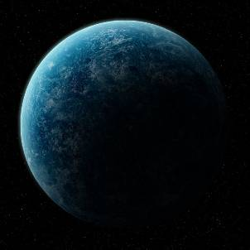
There is a nearby planet
which looks suitable.
You navigate towards it
in the hope that you can land.
Press the button

Slide 184
Question B 5 e
Calculate the volume of the prism below.
5 cm
4 cm
7 cm
3 cm
108 cm³
96 cm³
84 cm³
42 cm³

Slide 185
Correct answer
Press the button

Slide 186
Wrong answer
Press the button

Slide 187
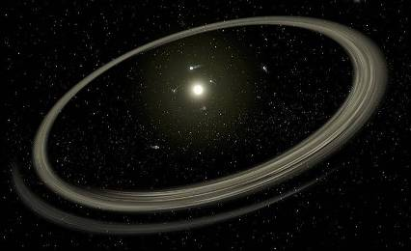
Scanning the area
you find that the nearest planetary system
is too far away for you to reach
with the damage
that your ship has sustained.
You head towards it in desperation,
but you know that
you will not make it!
Press the button

Slide 188
B 6

Slide 189
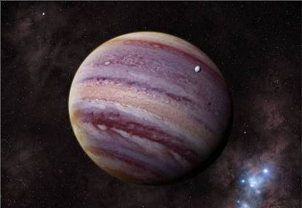
After years of searching you find a planet
which has everything
needed for survival.
Your new friends are overjoyed
that their civilization will be saved.
Press the button

Slide 190
Question B 6 a
Calculate the volume of the prism below.
3 cm
4 cm
5 cm
8 cm
7 cm
44 cm³
308 cm³
392 cm³
140 cm³

Slide 191
Correct answer
Press the button

Slide 192
Wrong answer
Press the button

Slide 193
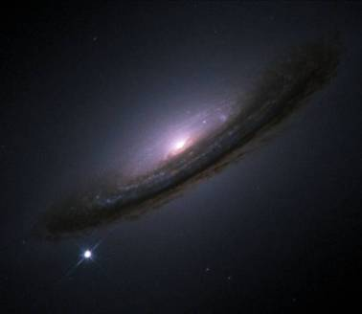
Together you search each planetary system in turn.
After years of searching
you still have not found any planets
suitable of supporting life.
Press the button

Slide 194
Question B 6 b
Calculate the volume of the prism below.
2 cm
3 cm
4 cm
6 cm
7 cm
24 cm³
168 cm³
210 cm³
105 cm³

Slide 195
Correct answer
Press the button

Slide 196
Wrong answer
Press the button

Slide 197
Although you are outnumbered,
you manage to overpower them.
You lock them in your quarters
and head for home,
towing their ship behind yours.
Press the button

Slide 198
Question B 6 c
Calculate the volume of the prism below.
3 cm
5 cm
6 cm
9 cm
8 cm
576 cm³
184 cm³
456 cm³
57 cm³

Slide 199
Correct answer
Press the button

Slide 200
Wrong answer
Press the button

Slide 201
You are outnumbered
but you are stronger than they are.
After a hard fight
you manage to beat the aliens,
but your ship’s instrument panel
was damaged in the struggle.
You are not able to control your ship
and so you drift in space,
unable to return home.
Press the button

Slide 202
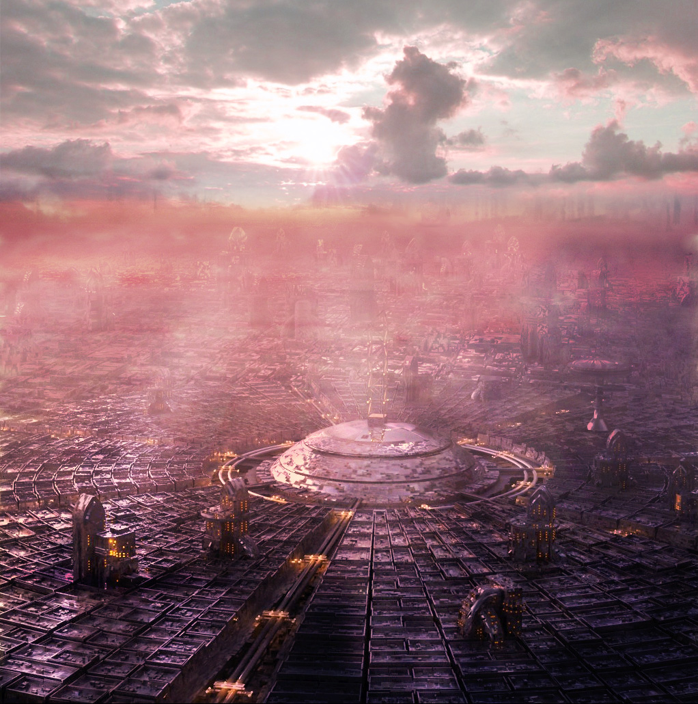
You make your way into the city
and begin looking for a way
to make your escape and return home.
Press the button

Slide 203
Question B 6 d
Calculate the volume of the prism below.
3 cm
4 cm
5 cm
8 cm
7 cm
308 cm³
44 cm³
392 cm³
140 cm³

Slide 204
Correct answer
Press the button

Slide 205
Wrong answer
Press the button

Slide 206
You don’t get far before you are recaptured.
After days of interrogation
you still refuse to tell them
the location of Earth.
They transfer you to a prison
where you spend the remainder of your days!
Press the button

Slide 207
The alien ship becomes a dot in the distance
and then disappears.
Press the button

Slide 208
Question B 6 e
Calculate the volume of the prism below.
2 cm
3 cm
4 cm
6 cm
7 cm
24 cm³
168 cm³
210 cm³
105 cm³

Slide 209
Correct answer
Press the button

Slide 210
Wrong answer
Press the button

Slide 211
You outrun the alien ship,
but you have travelled too far from home
and used too much fuel.
You do not have enough fuel
to make the journey home again!
Press the button

Slide 212
You manage to land safely.
The planet has all the resources
needed to support life.
Press the button

Slide 213
Question B 6 f
Calculate the volume of the prism below.
3 cm
5 cm
6 cm
9 cm
8 cm
576 cm³
184 cm³
456 cm³
57 cm³

Slide 214
Correct answer
Press the button

Slide 215
Wrong answer
Press the button

Slide 216
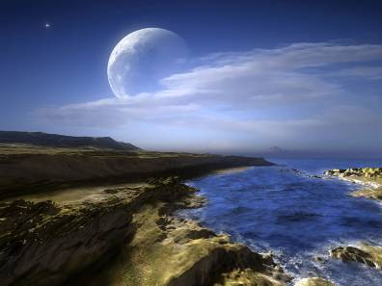
You land safely,
but the damage to your ship is too great,
you will not be able to take off again.
The planet’s atmosphere is suitable
and there is water,
but there are no other resources
needed to support life.
All you have to survive
are the supplies on the ship.
Once these run out,
your mission will end!
Press the button

Slide 217
Complete endings B

Slide 218
You wish them well
and then head for home.
With your news of a new civilization
you are hailed as the greatest explorer
there has ever been.
Press the button

Slide 219
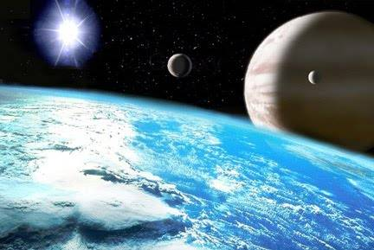
You need to return home
but you agree to search one more system.
To your surprise
the system has a planet
which can support life.
You return home
with news of a new civilization
and your part in saving it.
You are a hero.
Press the button

Slide 220
Your ship is in need of repairs.
You have no choice but to return home.
You have news of a new civilization,
but one which is running out of time
and one which you were not able to help.
Press the button

Slide 221
You arrive home safely.
With news of an alien civilization
together with the technology
you get from the aliens’ ship
you are treated as a hero.
Press the button

Slide 222
You arrive home safely.
You have news of an alien civilization
and new technology from the their ship.
But will they ever discover
the location of Earth
and what will happen if they do?
Press the button

Slide 223
You find a depot
where there are several space ships.
You sneak on board one of the ships.
The controls are different,
but you manage to work out
how to close the door and take off.
Nobody notices as you turn the ship
and head home.
Press the button

Slide 224
You find a place to live
whilst you work out what to do next.
After a while you begin to settle in.
You make a life for yourself here,
but it is not home.
Press the button

Slide 225
You decide you have had enough excitement for one journey.
You turn and head for home.
With news of the first contact
with an alien civilization,
you will be remembered
as a great explorer.
Press the button

Slide 226
Flying at full speed for such a distance
has put a great strain on the engine.
You need to find a planet to land the ship.
The planet you choose is beautiful
and has everything you need to survive,
but it will be a lonely survival.
Maybe one day you may return home.
Press the button

Slide 227
You make the necessary repairs
and then return home.
With news of alien life
and knowledge of a planet
capable of supporting human life
you are hailed as a great explorer.
Press the button

Slide 228
The ship is too damaged to take off again.
You are fortunate
to have landed on a planet
which is capable of supporting life.
You will be able to survive here.
Maybe one day you will be rescued.
Press the button

Slide 229
Feedback A

Slide 230
You need help with 1 – area of a parallelogram
2 – area of a triangle
Topics not covered yet 3, 4 – perimeter and area of a composite shape
5, 6 – surface area and volume of a cuboid
Try again
Press the button

Slide 231
You can do 1 – area of a parallelogram
You need help with 2 – area of a triangle
3 – perimeter of a composite shape
Topics not covered yet 4 – area of a composite shape
5, 6 – surface area and volume of a cuboid
Try again
Press the button

Slide 232
You can do 2 – area of a triangle
You need help with 1 – area of a parallelogram
3 – perimeter of a composite shape
Topics not covered yet 4 – area of a composite shape
5, 6 – surface area and volume of a cuboid
Try again
Press the button

Slide 233
You can do 1 – area of a parallelogram
2 – area of a triangle
You need help with 3, 4 – perimeter and area of a composite shape
Topics not covered yet 5, 6 – surface area and volume of a cuboid
Try again
Press the button

Slide 234
You can do 1 – area of a parallelogram
3 – perimeter of a composite shape
You need help with 2 – area of a triangle
4 – area of a composite shape
Topics not covered yet 5, 6 – surface area and volume of a cuboid
Try again
Press the button

Slide 235
You can do 2 – area of a triangle
3 – perimeter of a composite shape
You need help with 1 – area of a parallelogram
4 – area of a composite shape
Topics not covered yet 5, 6 – surface area and volume of a cuboid
Try again
Press the button

Slide 236
You can do 1 – area of a parallelogram
2 – area of a triangle
3 – perimeter of a composite shape
You need help with 4 – area of a composite shape
5 – surface area of a cuboid
Topics not covered yet 6 – volume of a cuboid
Try again
Press the button

Slide 237
You can do 1 – area of a parallelogram
2 – area of a triangle
4 – area of a composite shape
You need help with 3 – perimeter of a composite shape
5 – surface area of a cuboid
Topics not covered yet 6 – volume of a cuboid
Try again
Press the button

Slide 238
You can do 1 – area of a parallelogram
3 – perimeter of a composite shape
4 – area of a composite shape
You need help with 2 – area of a triangle
5 – surface area of a cuboid
Topics not covered yet 6 – volume of a cuboid
Try again
Press the button

Slide 239
You can do 2 – area of a triangle
3, 4 – perimeter and area of a composite shape
You need help with 1 – area of a parallelogram
5 – surface area of a cuboid
Topics not covered yet 6 – volume of a cuboid
Try again
Press the button

Slide 240
You can do all the topics covered – well done.
Now try Andromeda
Press the button

Slide 241
You can do 1 – area of a parallelogram
2 – area of a triangle
3, 4 – perimeter and area of a composite shape
5 – surface area of a cuboid
You only need help with 6 – volume of a cuboid
Do you want to try again?
Or maybe try Andromeda
Press the button

Slide 242
You can do 1 – area of a parallelogram
2 – area of a triangle
3, 4 – perimeter and area of a composite shape
6 – volume of a cuboid
You only need help with 5 – surface area of a cuboid
Do you want to try again?
Or maybe try Andromeda
Press the button

Slide 243
You can do 1 – area of a parallelogram
2 – area of a triangle
3, 4 – perimeter and area of a composite shape
You need help with 5, 6 – surface area and volume of a cuboid
Try again
Press the button

Slide 244
You can do 1 – area of a parallelogram
2 – area of a triangle
3 – perimeter of a composite shape
5, 6 – surface area and volume of a cuboid
You only need help with 4 – area of a composite shape
Do you want to try again?
Or maybe try Andromeda
Press the button

Slide 245
You can do 1 – area of a parallelogram
2 – area of a triangle
3 – perimeter of a composite shape
5 – surface area of a cuboid
You need help with 4 – area of a composite shape
6 – volume of a cuboid
Try again
Press the button

Slide 246
You can do 1 – area of a parallelogram
2 – area of a triangle
4 – area of a composite shape
5, 6 – surface area and volume of a cuboid
You only need help with 3 – perimeter of a composite shape
Do you want to try again?
Or maybe try Andromeda
Press the button

Slide 247
You can do 1 – area of a parallelogram
2 – area of a triangle
4 – area of a composite shape
5 – surface area of a cuboid
You need help with 3 – perimeter of a composite shape
6 – volume of a cuboid
Try again
Press the button

Slide 248
You can do 1 – area of a parallelogram
3, 4 – perimeter and area of a composite shape
5, 6 – surface area and volume of a cuboid
You only need help with 2 – area of a triangle
Do you want to try again?
Or maybe try Andromeda
Press the button

Slide 249
You can do 1 – area of a parallelogram
3, 4 – perimeter and area of a composite shape
5 – surface area of a cuboid
You need help with 2 – area of a triangle
6 – volume of a cuboid
Try again
Press the button

Slide 250
You can do 2 – area of a triangle
3, 4 – perimeter and area of a composite shape
5, 6 – surface area and volume of a cuboid
You only need help with 1 – area of a parallelogram
Do you want to try again?
Or maybe try Andromeda
Press the button

Slide 251
You can do 2 – area of a triangle
3, 4 – perimeter and area of a composite shape
5 – surface area of a cuboid
You need help with 1 – area of a parallelogram
6 – volume of a cuboid
Try again
Press the button

Slide 252
Feedback B

Slide 253
You need help with 1, 2 – problems involving perimeter and area
Topics not covered yet 3 – area of a trapezium
4, 5, 6 – surface area and volume of a prism
Try again
Press the button

Slide 254
You can do 1 – problems involving perimeter of a rectangle
You need help with 2 – problems involving area of a triangle
3 – area of a trapezium
Topics not covered yet 4, 5, 6 – surface area and volume of a prism
Try again
Press the button

Slide 255
You can do 2 – problems involving area of a triangle
You need help with 1 – problems involving perimeter of a rectangle
3 – area of a trapezium
Topics not covered yet 4, 5, 6 – surface area and volume of a prism
Try again
Press the button

Slide 256
You can do 1, 2 – problems involving perimeter and area
You need help with 3 – area of a trapezium
4 – surface area of a prism
Topics not covered yet 5 ,6 – volume of a prism
Try again
Press the button

Slide 257
You can do 1 – problems involving perimeter of a rectangle
3 – area of a trapezium
You need help with 2 – problems involving area of a triangle
4 – surface area of a prism
Topics not covered yet 5, 6 – volume of a prism
Try again
Press the button

Slide 258
You can do 2 – problems involving area of a triangle
3 – area of a trapezium
You need help with 1 – problems involving perimeter of a rectangle
4 – surface area of a prism
Topics not covered yet 5, 6 – volume of a prism
Try again
Press the button

Slide 259
You can do 1, 2 – problems involving perimeter and area
3 – area of a trapezium
You need help with 4, 5 – surface area and volume of a prism
Topics not covered yet 6 – volume of a composite prism
Try again
Press the button

Slide 260
You can do 1, 2 – problems involving perimeter and area
4 – surface area of a prism
You need help with 3 – area of a trapezium
5 – volume of a prism
Topics not covered yet 6 – volume of a composite prism
Try again
Press the button

Slide 261
You can do 1 – problems involving perimeter of a rectangle
3 – area of a trapezium
4 – surface area of a prism
You need help with 2 – problems involving area of a triangle
5 – volume of a prism
Topics not covered yet 6 – volume of a composite prism
Try again
Press the button

Slide 262
You can do 2 – problems involving area of a triangle
3 – area of a trapezium
4 – surface area of a prism
You need help with 1 – problems involving perimeter of a rectangle
5 – volume of a prism
Topics not covered yet 6 – volume of a composite prism
Try again
Press the button

Slide 263
You can do all the topics covered – well done.
You can now retire.

Slide 264
You can do 1, 2 – problems involving perimeter and area
3 – area of a trapezium
4, 5 – surface area and volume of a prism
You only need help with 6 – volume of a composite prism
Do you want to try again?
Press the button

Slide 265
You can do 1, 2 – problems involving perimeter and area
3 – area of a trapezium
4 – surface area of a prism
6 – volume of a composite prism
You only need help with 5 – volume of a prism
Do you want to try again?
Press the button

Slide 266
You can do 1, 2 – problems involving perimeter and area
3 – area of a trapezium
4 – surface area of a prism
You need help with 5, 6 – volume of a prism
Try again
Press the button

Slide 267
You can do 1, 2 – problems involving perimeter and area
3 – area of a trapezium
5, 6 – volume of a prism
You only need help with 4 – surface area of a prism
Do you want to try again?
Press the button

Slide 268
You can do 1, 2 – problems involving perimeter and area
3 – area of a trapezium
5 – volume of a prism
You need help with 4 – surface area of a prism
6 – volume of a composite prism
Try again
Press the button

Slide 269
You can do 1, 2 – problems involving perimeter and area
4, 5, 6 – surface area and volume of a prism
You only need help with 3 – area of a trapezium
Do you want to try again?
Press the button

Slide 270
You can do 1, 2 – problems involving perimeter and area
4, 5 – surface area and volume of a prism
You need help with 3 – area of a trapezium
6 – volume of a composite prism
Try again
Press the button

Slide 271
You can do 1 – problems involving perimeter of a rectangle
3 – area of a trapezium
4, 5, 6 – surface area and volume of a prism
You only need help with 2 – problems involving area of a triangle
Do you want to try again?
Press the button

Slide 272
You can do 1 – problems involving perimeter of a rectangle
3 – area of a trapezium
4, 5 – surface area and volume of a prism
You need help with 2 – problems involving area of a triangle
6 – volume of a composite prism
Try again
Press the button

Slide 273
You can do 2 – problems involving area of a triangle
3 – area of a trapezium
4, 5, 6 – surface area and volume of a prism
You only need help with 1 – problems involving perimeter of a rectangle
Do you want to try again?
Press the button

Slide 274
You can do 2 – problems involving area of a triangle
3 – area of a trapezium
4, 5 – surface area and volume of a prism
You need help with 1 – problems involving perimeter of a rectangle
6 – volume of a composite prism
Try again
Press the button

